Slide 1







PREDICTING RESUME AND JOB SUCCESS:
A MULTIPLE AND LOGISTIC REGRESSION ANALYSIS
STAT 632 Final Project
Presenters:
Parth Bhagwat
Muhammad Sualeh Alam
Ashish Ashish
Sophia Tejeda
Notes:
Sophia

Slide 2




AGENDA
OUTLINE
Introduction
01
Model Assumptions
05
Data Collection and Cleaning
02
Multiple Linear Regression Model
06
Project Overview
03
Logistic Regression Model
07
Descriptive Statistics
04
Challenges and Future Work
08
Notes:
Sophia

Slide 3






Motivations behind the project
INTRODUCTION
01
Finding the perfect job can often feel like a guessing game. How do we know if our resume truly matches what an employer is looking for?
02
We apply multiple and logistic regression to score resumes and predict hiring outcomes.
03
Our goal is to make the job search smarter, more strategic, and backed by statistics.
Notes:
Sophia

Slide 4









DATA COLLECTION AND CLEANING
Predictor variables: Skills Matched, Experience Years, Experience Level (Junior, Mid, Senior).
After cleaning for missing and incomplete data, we kept 114 resumes.
Response variables: Score (MLR) and Decision (LR).
Initial dataset: 234 resumes collected.
Notes:
Lets start with the Data Collection story and how this project started....
This all goes back to when I asked Dr Kerr after the end of the class that "I am thinking to build a NLP related ATS Resume Scanner project with a full Front-End, back-End interconnected to Tableau Dashboard for Data Visualization",
AND he said you are welcome to try it and motivated me to do so. and I still remember his exact words: 'I Really like that confidence!', haha...
Well, Thank you so much Dr Kerr for the confidence and motivation for this project :)
That one line gave me a HUGE BOOST... and that’s when I decided I wouldn’t just do a project from the syllabus. I wanted to go above and beyond the course contents..
Slide1:
An important point to note here is that we did not rely on any EXTERNAL DATASETS. We created our entire database from scratch by scanning resumes (one-by-one) submitted by family and friends...
So moving on... We started with 234 raw resumes submitted on our ATS scanner.
After carefully reviewing the data, we cleaned out missing entries, and finalized a dataset of 114 resumes that were fully usable for analysis.
Although there were different variables, we only selected TotalSkillsMatched, Exp Years and Exp Level (Junior 0-2, Mid 2-5, Senior 5+)
Then on these predictor variables we used MLR (to predict scores) and LR (to predict hiring outcome)

Slide 5

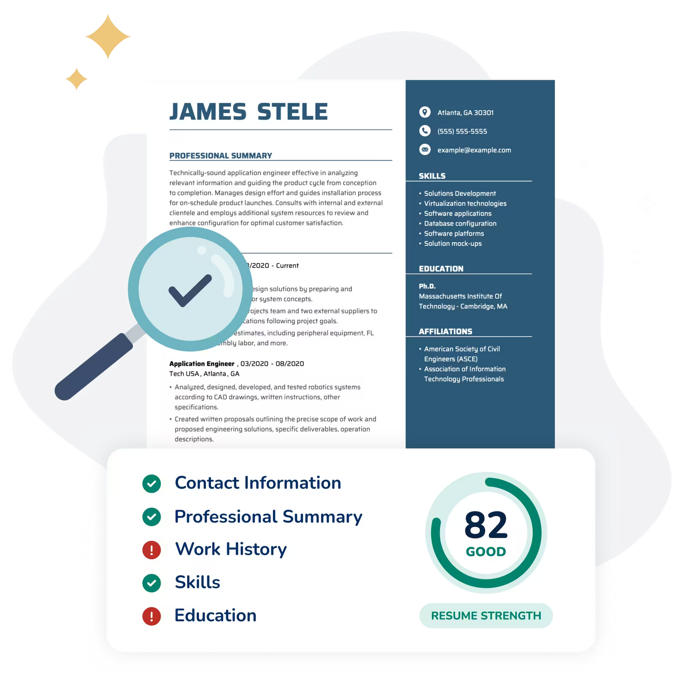

PROJECT OVERVIEW
Participants uploaded their resumes, job descriptions, and hiring outcomes (hired/rejected).
We extracted features: skills matched, experience years, and experience level.
The program generated a score (0-100) reflecting the strength of the match.
We created a binary decision variable (hired = 1, rejected = 0) to apply logistic regression.
Notes:
In this project.....
1. Basic Flow: Participants uploaded their resumes, and the job descriptions they were applying to:
Based on these features, the ATS Scanner generated a Score — ranging from 0 to 100 — to quantify how well a resume matched the job requirements. based on several factors like Total Number Of Skills Matched, Number of Years of Experience Matched, and Similarity of the content on Resume And Job Description. It was all combined to create a score out of 100
**Instead of me reading the slides I think you all will understand the project much better with a live-project demo.** 🤣
"So let's take a quick look into the Resume ATS Scanner and how it works end-to-end.
🎬 PROJECT DEMO: 🎬
*This is the Front-End view of the Web Application:
We have some cool features like Dark Mode for people who like it. Furthermore, we have Tableau dashboard integrated for Data Visualization for all the resumes in the system.
🎬 PROJECT DEMO END: 🎬
There's one more thing I would like to add
We also converted the hiring outcome into a binary "Decision" variable (basically a Derived column from existing data so we could apply LR)— where 'Hired' equals 1 and 'Rejected' equals 0 — and applied logistic regression to predict that outcome.
ENDING:
This end-to-end project showcases a practical, real-world application of resume screening and predictive modeling using data that we gathered and cleaned ourselves."
Our goal wasn't just to analyze data, instead it was to build a Working Full Stack Prototype of an ATS Resume System, one that's built from real, hands on experience.

Slide 6
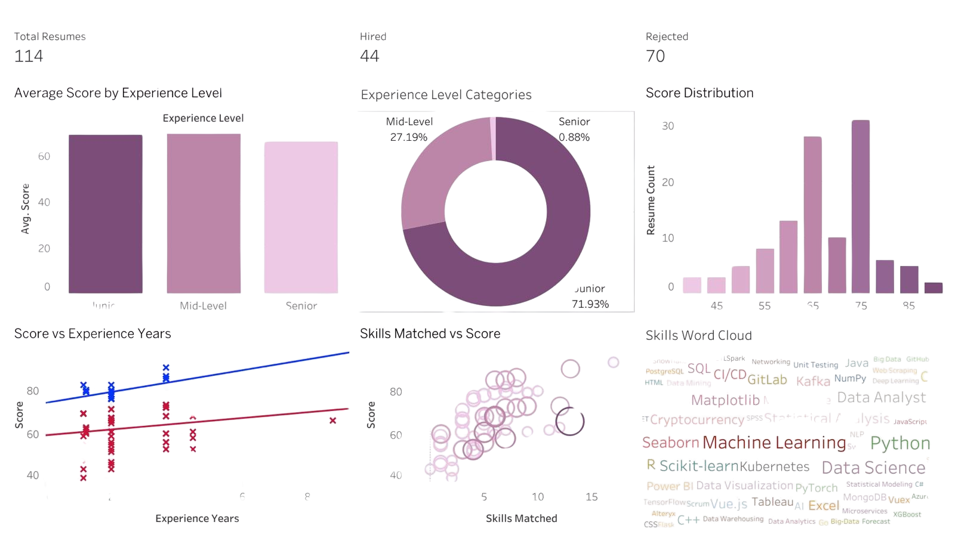
DESCRIPTIVE STATISTICS
Dashboard Link: https://public.tableau.com/app/profile/ashish.ashish3477/viz/Book1_17455698844530/Dashboard1
Notes:
Ashish

Slide 7


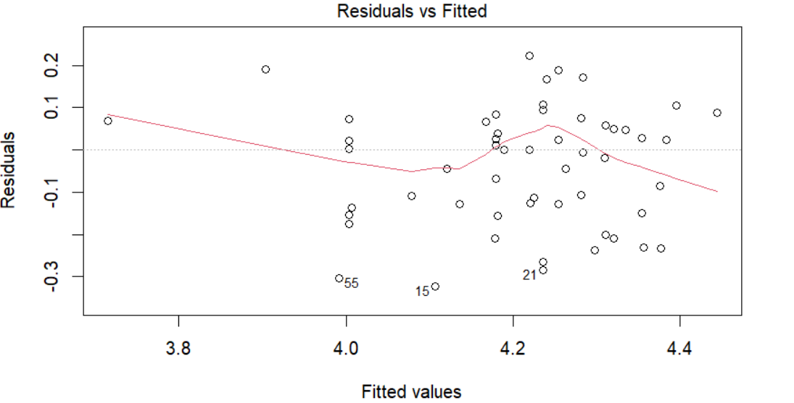
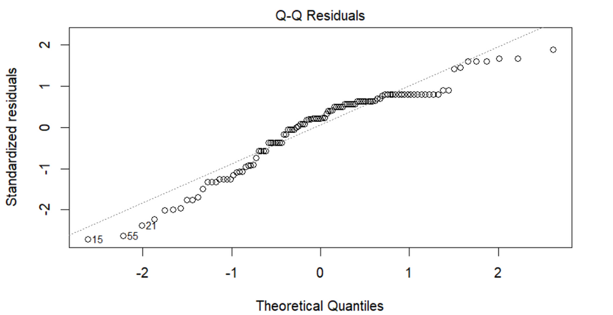






MODEL ASSUMPTIONS
Constant Variance (Homoscedasticity) checked with residual plots: no major issues found.
Linearity : relationships looked reasonably linear after transformations.
Normality checked with Shapiro-Wilk Test on residuals // QQ plot.
Notes:
Ashish
For linearity when we made a scatterplot matrix we saw the coefs were approx linear, so we can proceed.
for constant varience theresd no fan shape so constant varience is reasonably achieved.
the QQ plot shows most of the residual points closely aligned with the reference line, so normality is also reasonably achieved.

Slide 8

MULTIPLE LINEAR REGRESSION
Model Equation
log(Score) = 3.682 + 0.212*log(ExperienceYears) + 0.252*log(Skillsmatched) - 0.228*Level1 - 0.618*Level2
Significant Predictors (based on p-values < 0.05):
R²adj = 0.4458; (44.58% of variance explained )
Transformations (sqrt/log) helped improve linearity and spread.
More experience and more skills matched lead to a higher score.
Mid-level candidates score slightly lower, and senior candidates score significantly lower than juniors.
log(ExperienceYears) | p = 0.000455
log(Skillsmatched) | p = 2e-16
Experience Level (Junior compared to Mid-Level) | p = 9.2e-05
Experience Level (Senior compared to Mid-Level) | p = 0.000202
Notes:
Parth
When experience years, skills matched are at baseline (log(1)), and at the baseline experience level (mid-level), the expected log(Score) is 3.682
If we hold experience years and skills matched constant, junior-level candidates have the highest expected resume scores.
Mid-level candidates score slightly lower, and senior candidates score significantly lower than juniors.
Meanwhile, increasing years of experience or the number of matched skills slightly but steadily improves the resume score.
The general trend is what you would expect:
More experience and more skills matched lead to a higher score.

Slide 9
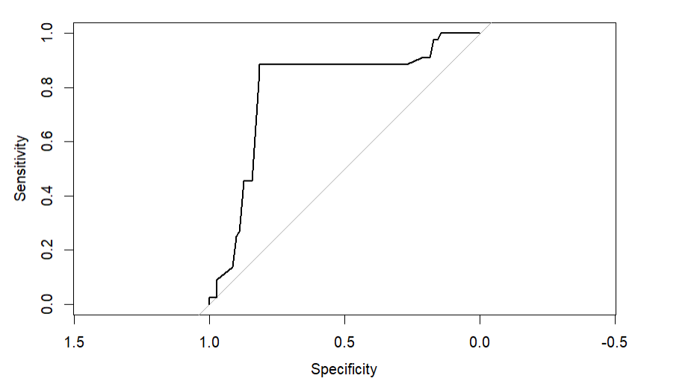
LOGISTIC REGRESSION MODEL
Significant Predictors (based on p-values < 0.05):
ROC CURVE
Experience Years | p = 0.0310
Skills Matched | p = 0.0004
Experience Level (Junior compared to Mid-Level) | p = 0.0029
ROC Curve AUC: 0.7937 ( good classification performance since is closer to 1)
AIC (Akaike Information Criterion) : 136.88;
suggest better fitting model
log(p/1−p​)=−4.8897+1.5633×(Experience Years)+0.3985×(Skills Matched)−5.4953×(Experience Level(Junior)​)
Notes:
Sophia

Slide 10
CONFUSION MATRIX
Confusion Matrix | Predicted: 0 | Predicted: 1
Actual: 0 | 60 | 24
Actual: 1 | 10 | 20
Overall Accuracy (70.2%): Decent — the model is correct ~70% of the time.
Sensitivity (45.5%): This is low — it’s only correctly identifying 45.5% of the actual 1s (positives).
Specificity (85.7%): Pretty good — it's doing well at predicting 0s.
(hired = 1, rejected = 0)
Notes:
Sophia

Slide 11


CHALLENGES AND FUTURE WORK
Integrate AI (GPT-4/BERT) – For better job-to-resume matching.
ML Advanced Models added like Random Forest, or Deep Learning)
Small Sample Size: Expanding the dataset would strengthen model conclusions
Add Multi-Resume Support (.word, .txt, DOCX format)
Notes:
Parth

Slide 12





THANK YOU!
ANY QUESTIONS?

